Slide 1
Temperature sensor DC Fan

Slide 2
FUTURE INSTITUTE OF TECHNOLOGY
Department of Electronics & Communication Engineering
3rd Year (6th Semester)
Group Number: A-2
Group Members: 5
Group Member Names:
Anisha Roy (Roll No. 34200318037)
Baijayanta Mukherjee (Roll No. 34200318034)
Nabarka Roy (Roll No. 34200318023)
Riya Das (Roll No. 34200318017)
Samadrita Sarkar (Roll No. 34200318014)

Slide 3

Contents
Aim
Components used
Software used
Circuit diagram
Simulation
Project Flow
Advantages
Future scope
Conclusion

Slide 4
Aim
The purpose of creating a project called temperature sensor DC fan is to control the speed of the fan according to the outside temperature.
So it can prevent waste of energy when it is not hot enough for a fan to be needed.

Slide 5
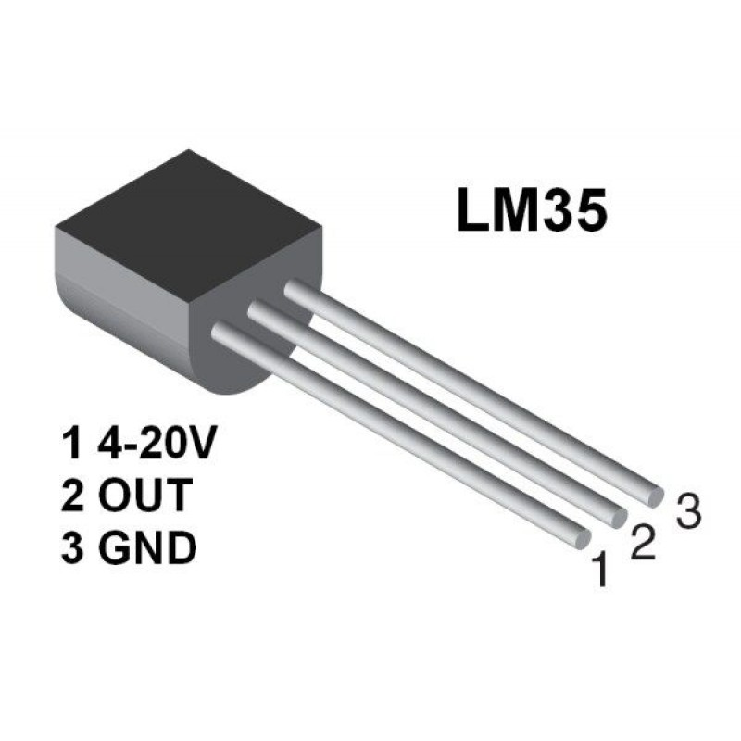
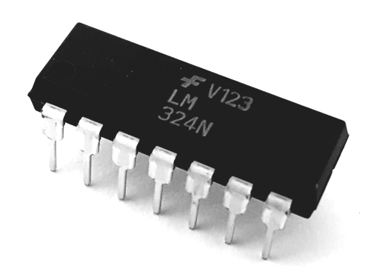
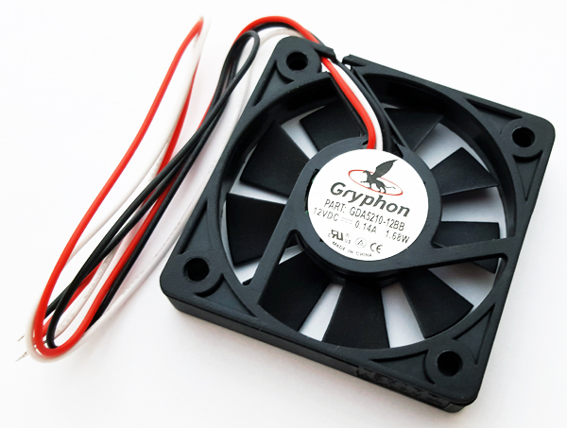
Components used
Power Supply
LM35
LM324
Relays
Relay 2P
DC Fan
Voltmeters

Slide 6

Software used
Proteus 8.1 Professional SP1
Link

Slide 7
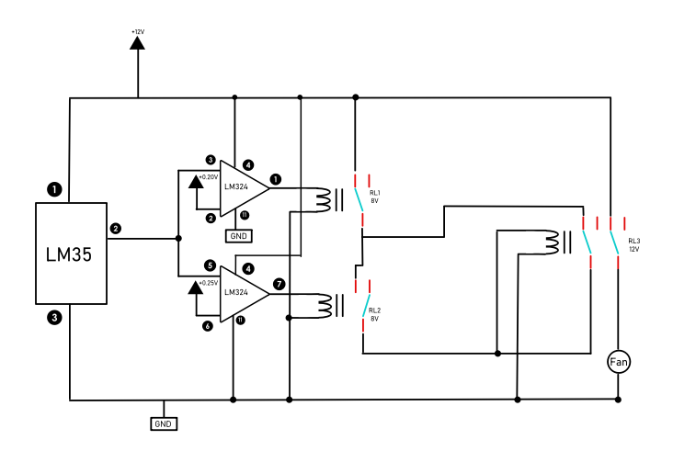
Circuit diagram

Slide 8
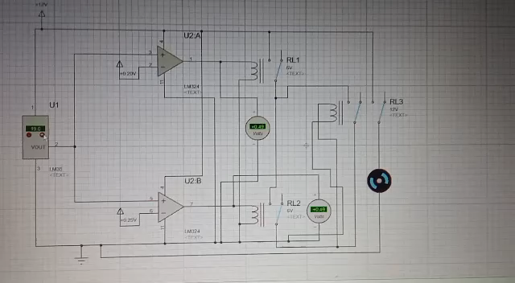
Simulation

Slide 9
Project flow
Detect surrounding temperature
If temperature is equal to 20°C
RL1 get close
If temperature is greater than 25°C
RL2 get close
Fan OFF
RL1 get open
If temperature is less than 20°C
RL2 get open
If temperature is less than 25°C

Slide 10
Advantages
This project can be used in Home, Industry.
This will help in saving the energy / electricity.
To monitor the environments that is not comfortable or possible for humans to monitor , especially for extended periods of time.
To assist people who are disable to adjust the fan speed automatically.

Slide 11
Future scope
We can monitor more parameters like humidity, lights and at the same time control them.
We send this data to a remote location using mobile or internet.
We can draw graphs of variations in these parameters using computer.

Slide 12
Conclusion
The main objective of this project has been achieved which was to design an automated fan which would start at a threshold temperature of 25°C and stop when the temperature goes below 20°C.
While doing this project the use of single polarity OP-Amp like LM324 is advisable.
All the packages of Proteus should be installed before simulating the project.

Slide 13
Thank you !

